Slide 1


Your Knowledge - YK Presentation
Artheesh E
Deepak Raja
Dinesh
Dharaneshwaran

Slide 2

CONTENTS
Objectives
2. Problem statement
3. Solution
4. Target Audience
5. User Reseach
6. Competitor Analysis
7. Feature Analysis
8. SWOT Analysis

Slide 3

1. Objectives
The main objective of using Your knowledge-YK is to effectively visualize and organize information through various diagramming tools such as mind maps, flowcharts, organizational charts, UML diagrams, concept maps, and project roadmaps.
Your knowledge-YK aims to simplify complex ideas, enhance creativity, and improve planning and communication in both academic and professional environments.
By utilizing these visual tools, users can brainstorm ideas, structure projects, design workflows, and present information in a clear and systematic manner, ultimately boosting productivity and decision-making efficiency.

Slide 4

2. Problem Statement
In many academic and professional settings, individuals and teams struggle to organize ideas, plan projects, and communicate complex information effectively.
Traditional note-taking or text-based planning methods often lead to confusion, loss of clarity, and inefficiency.
There is a need for a visual, collaborative, and easy-to-use tool that can help users structure their thoughts, workflows, and projects in a more logical and engaging manner.
Your knowledge-YK addresses this challenge by providing mind maps, flowcharts, organizational charts, UML diagrams, concept maps, and project roadmaps that transform abstract ideas into clear visual representations.

Slide 5

3. Solution
Your knowledge-YK provides an intuitive and versatile platform that solves the problem of organizing and visualizing complex information.
It allows users to create mind maps, flowcharts, organizational charts, UML diagrams, concept maps, and project roadmaps, enabling clear representation of ideas and workflows.
With features like templates, drag-and-drop editing, AI-assisted mind mapping, collaboration tools, and cloud storage, Your knowledge-YK makes brainstorming, planning, and project management faster, easier, and more efficient.
By transforming abstract thoughts into structured visual diagrams, Your knowledge-YK enhances understanding, productivity, and communication for individuals and teams alike.

Slide 6



4. Target Audience
The target audience for Your Knowledge-YK includes a wide range of individuals and groups who require effective visual planning and organization tools. This includes:
Students
Teachers and Educators
Professionals and Teams
for creating study notes, project outlines, and research diagrams.
for designing lesson plans, course structures, and concept explanations.
for project planning, workflow visualization, and collaborative brainstorming.
Business Analysts and Managers
Software Developers
for organizational charts, process mapping, and decision-making tools.
for UML diagrams, system architecture planning, and algorithm visualization.

Slide 7
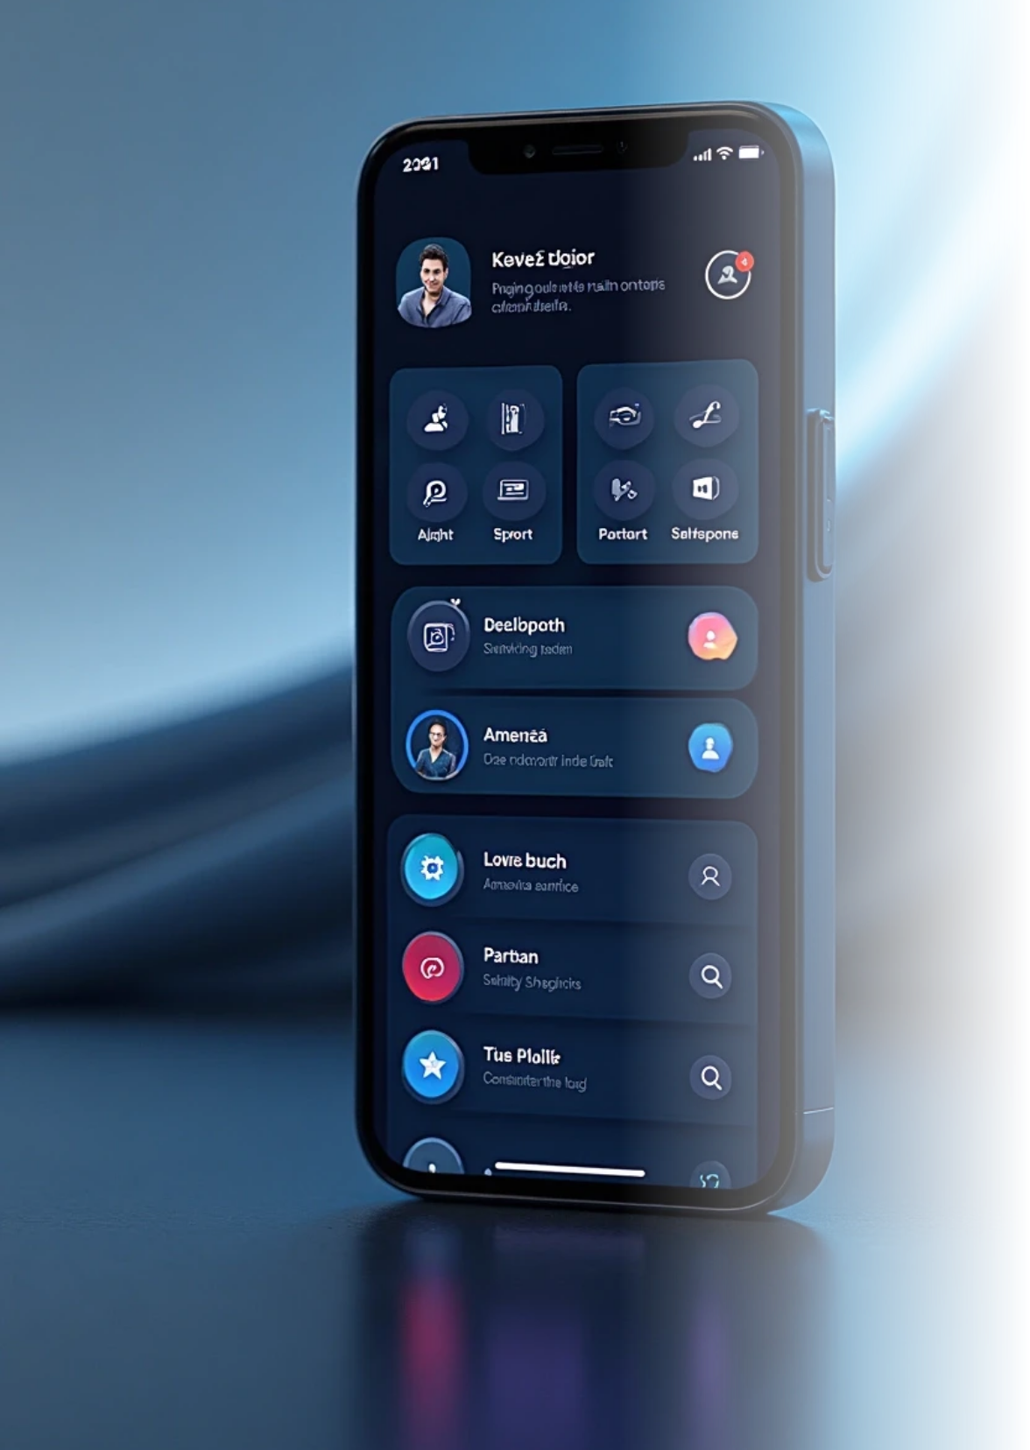
5. User Research
User Goals: Users want fast, intuitive access to core features with minimal learning curve.
Pain Points: Navigation is confusing; users struggle to find key actions or tools.
Behavior Patterns: Users often abandon tasks halfway due to friction or poor feedback.
Needs: Clear onboarding, accessible support, and customizable workflows.
Preferences: Mobile-first design, dark mode, and minimal UI clutter are highly valued.
Opportunities: Add smart suggestions, improve UX writing, and streamline user journeys.

Slide 8
6. Competitor Analysis
Metric / Feature | GitMind | YK | Ayoa
Maximum map size / performance (large maps) | Moderate (browser + web constraints) | High (desktop, local memory) | Good up to certain complexity (browser + backend limits)
Task / project management integration | Basic or limited | None (pure mapping) | Strong (tasks, boards, deadlines integrated)
Export / interoperability | Good (PNG, JPG, PDF, text, outline) | Very good (SVG, PDF, etc.) | Decent, with integrations and export support
Customization / advanced features | Good | Very high (scripting, conditional styling, add-ons) | Moderate (templates, UI configurations)

Slide 9
7. Feature Analysis
Feature Category | GitMind | YK | Ayoa
Offline usage (fully functional) | ❌ | ✅ | ⚠️
Open-source software | ❌ | ✅ | ❌
Custom themes & node styling | ✅ | ✅ | ✅
Completely free (no paid version) | ⚠️ | ✅ | ❌

Slide 10
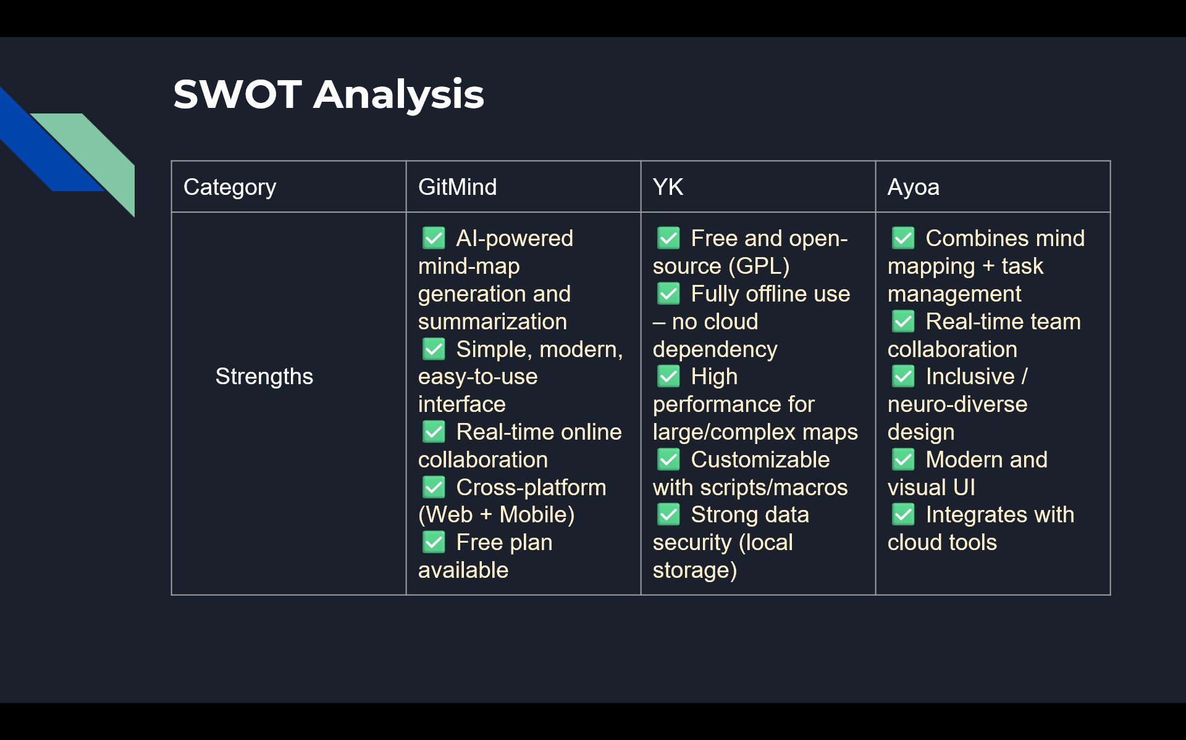

Slide 11
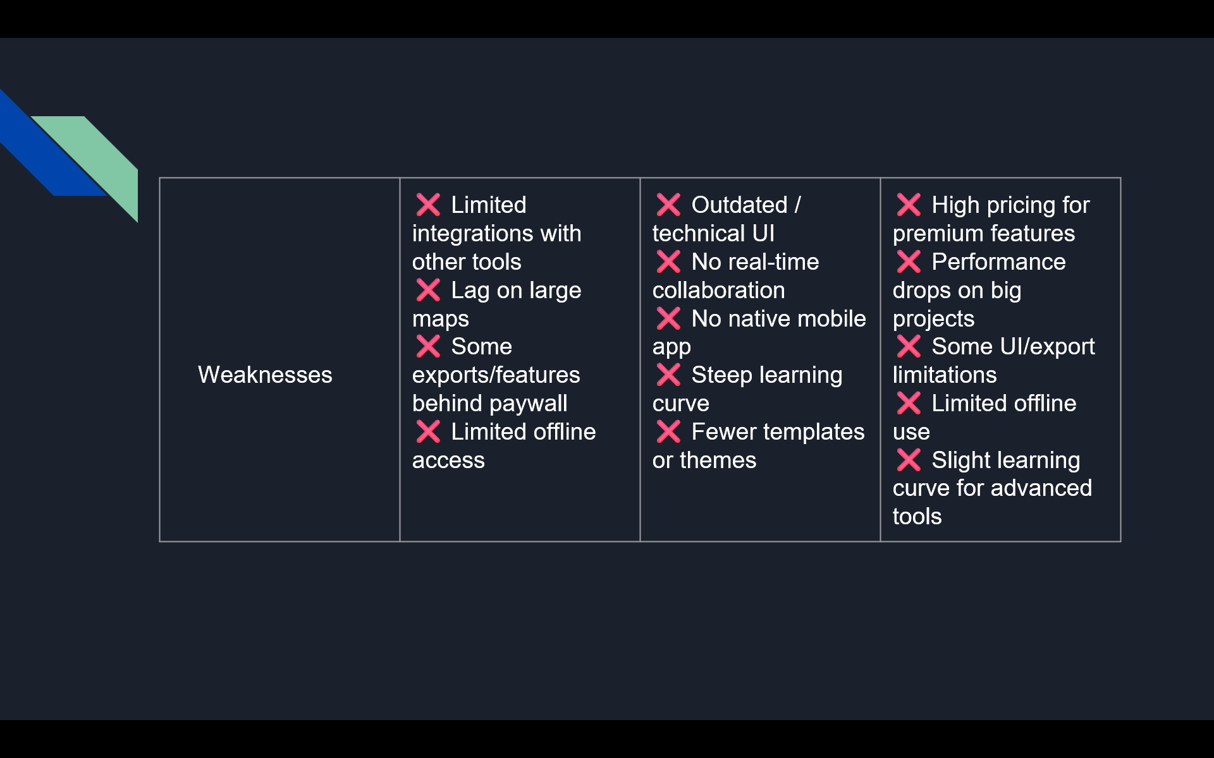

Slide 12
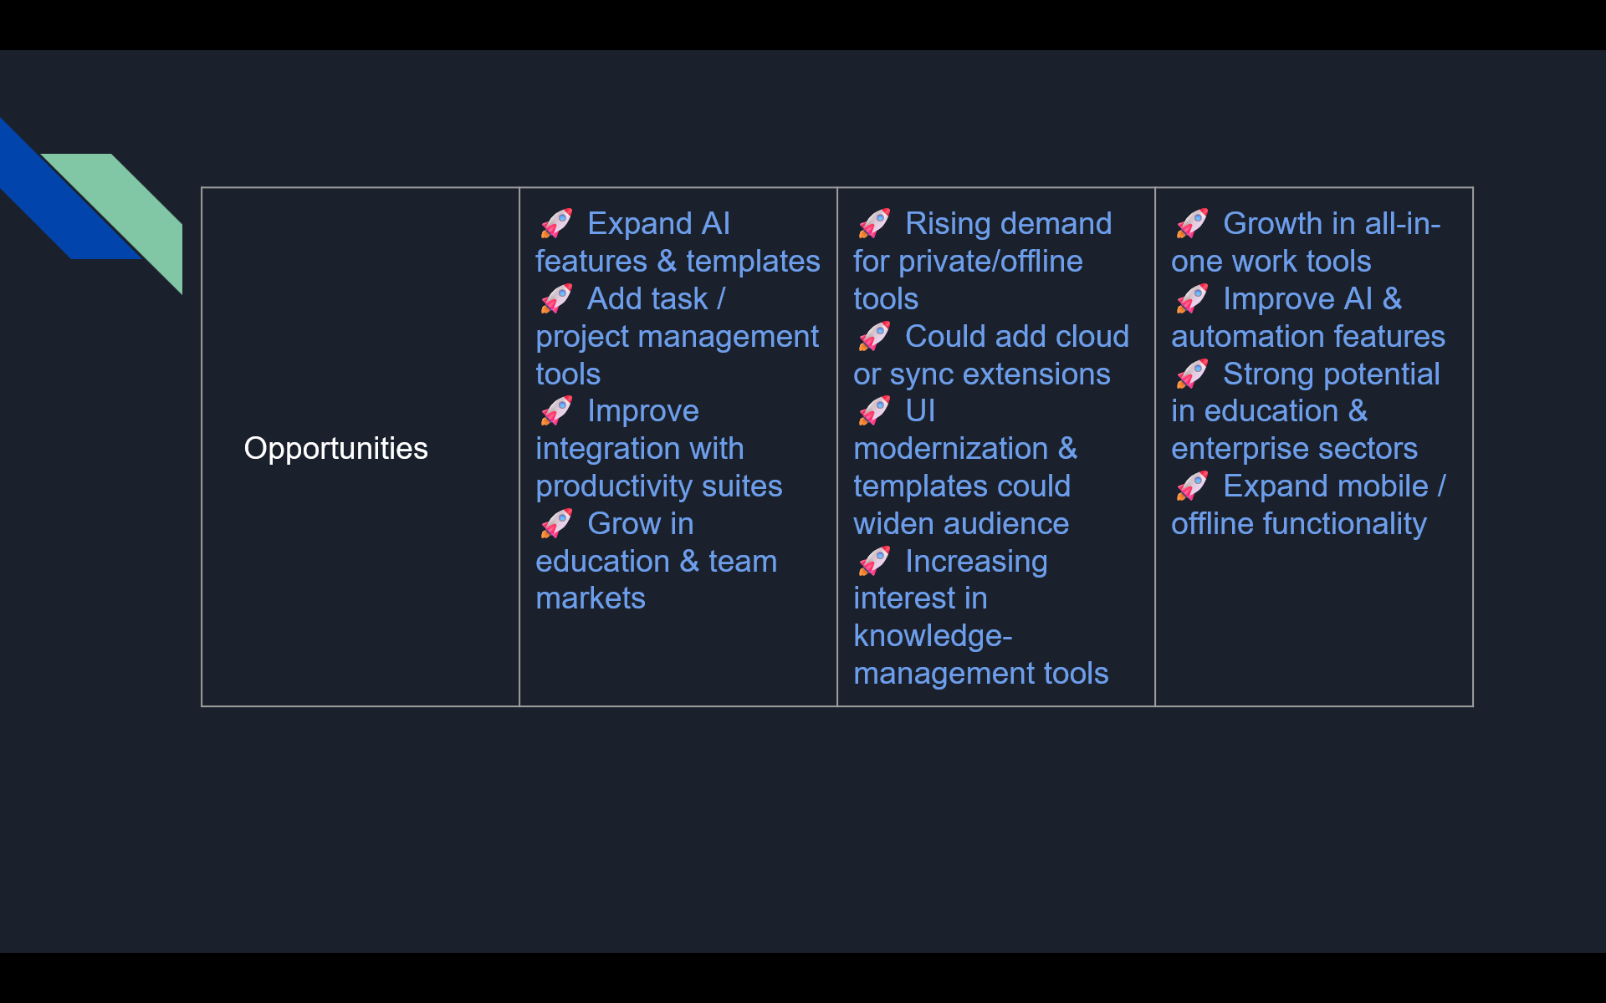

Slide 13
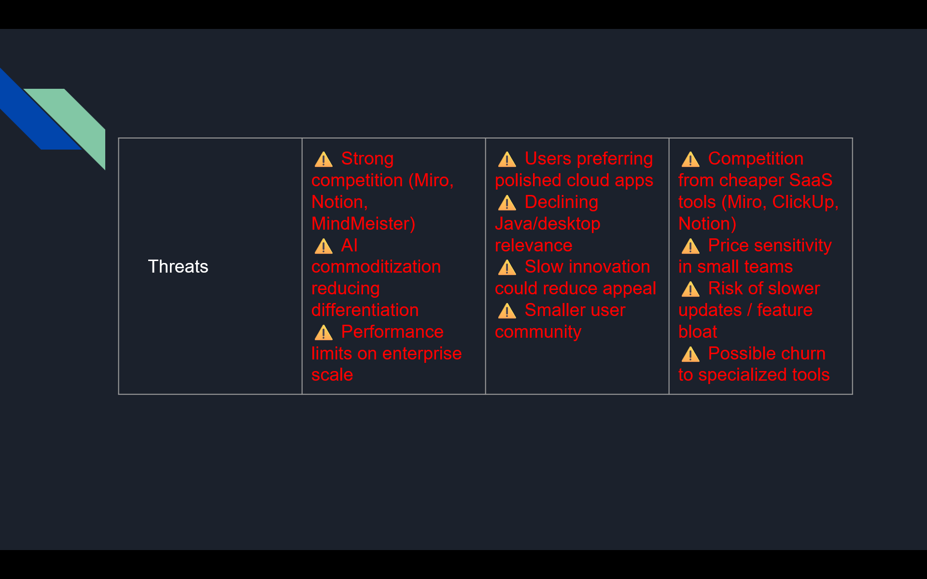

Slide 14
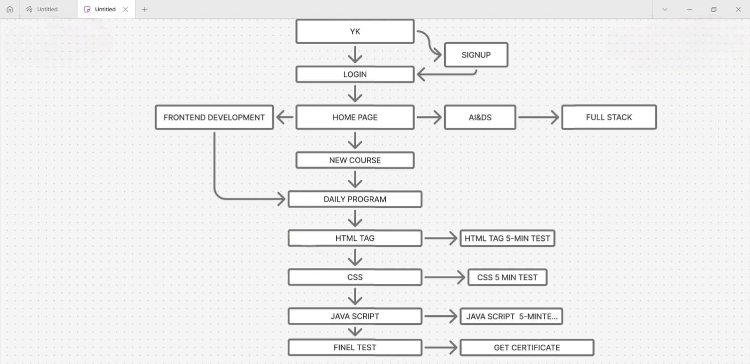

Slide 15
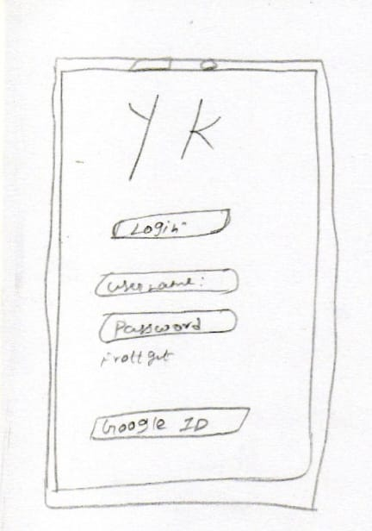
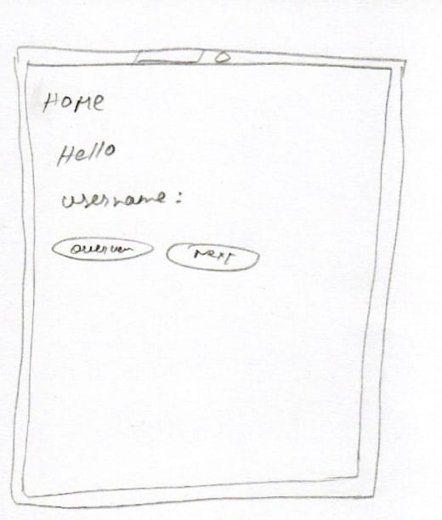

Slide 16
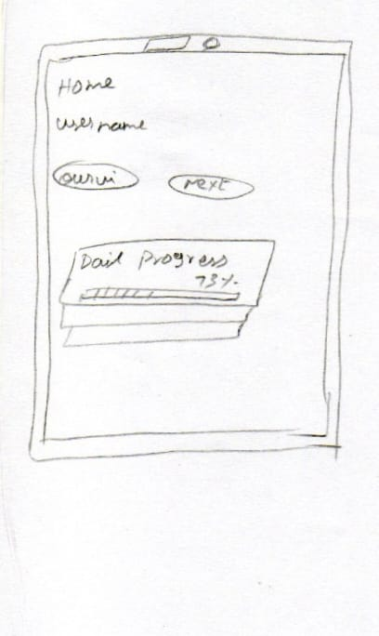
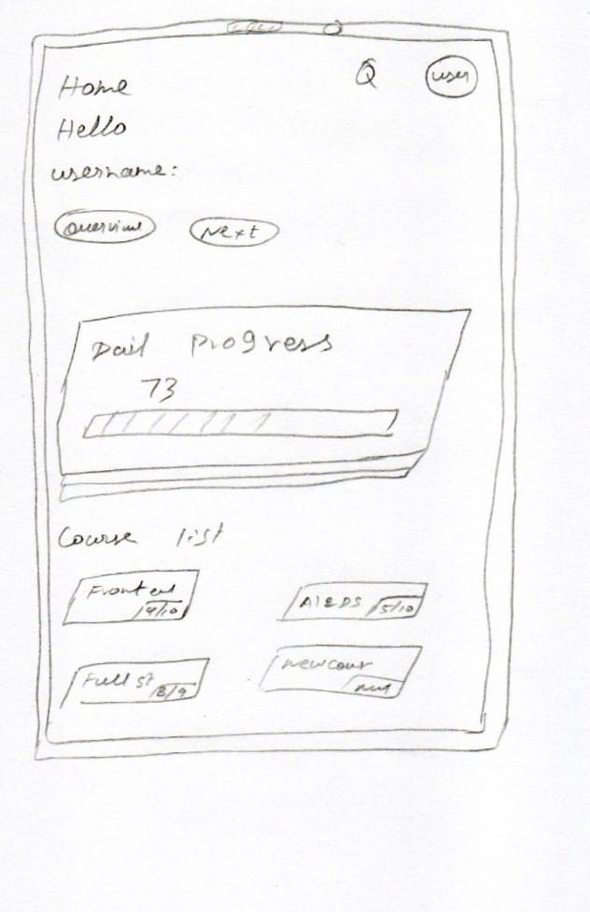

Slide 17
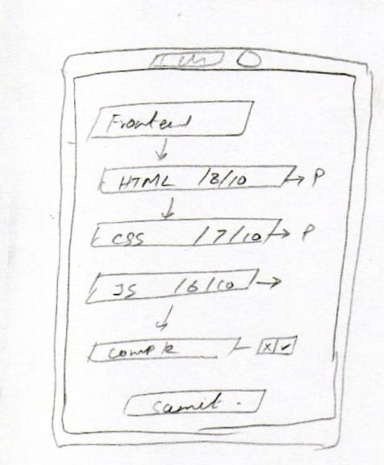
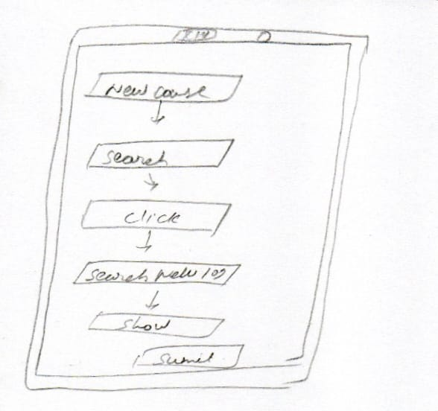

Slide 18
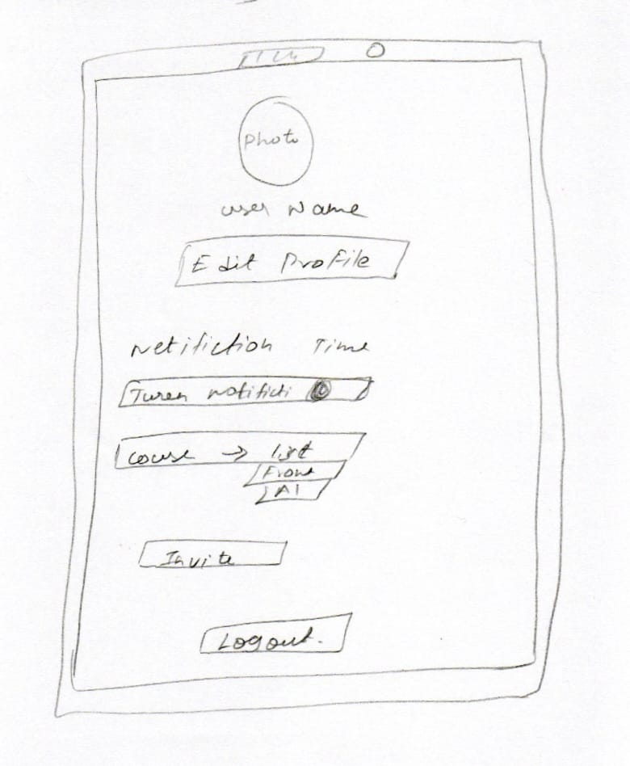
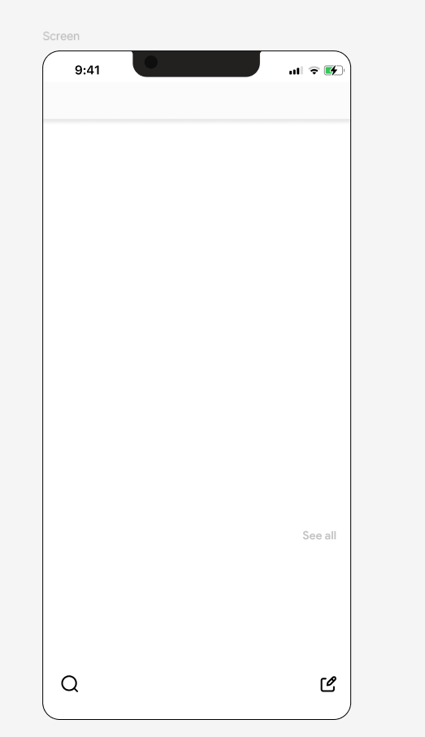

Slide 19
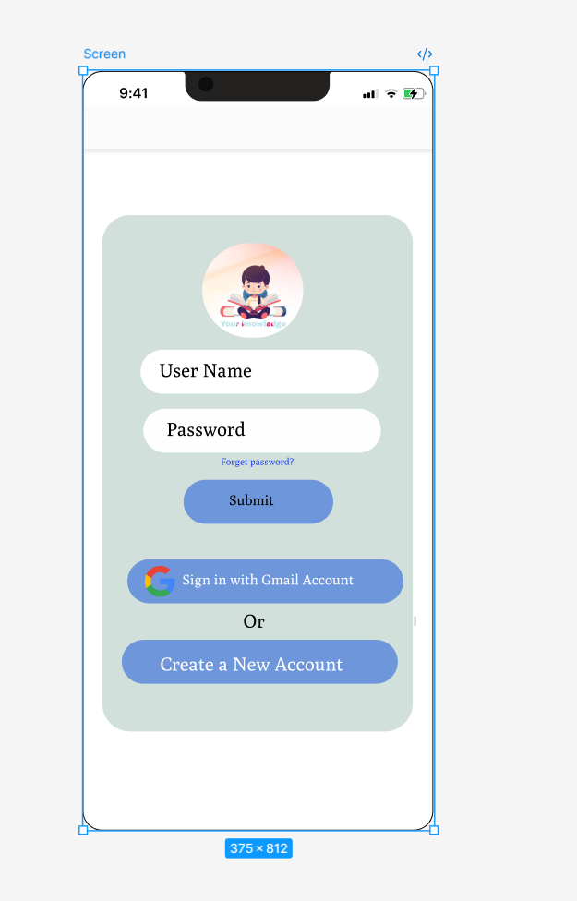

Slide 20
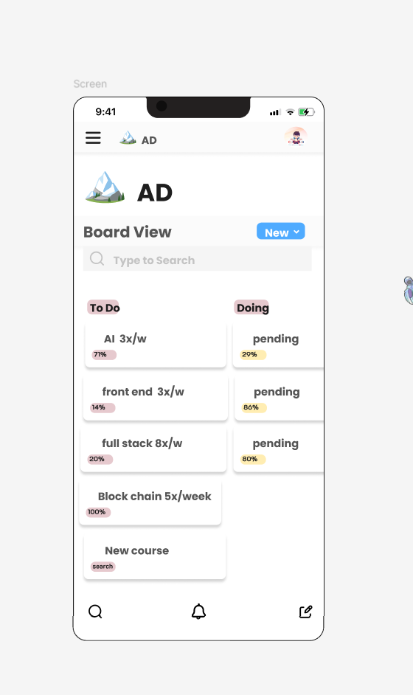
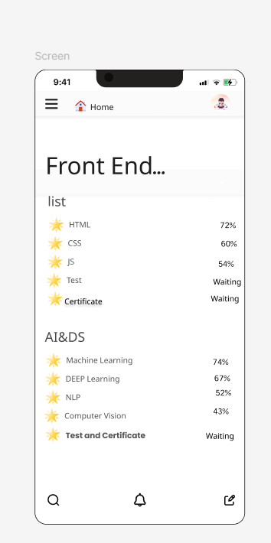
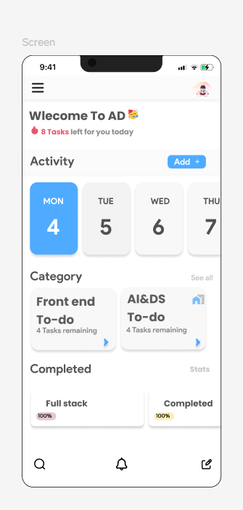

Slide 21
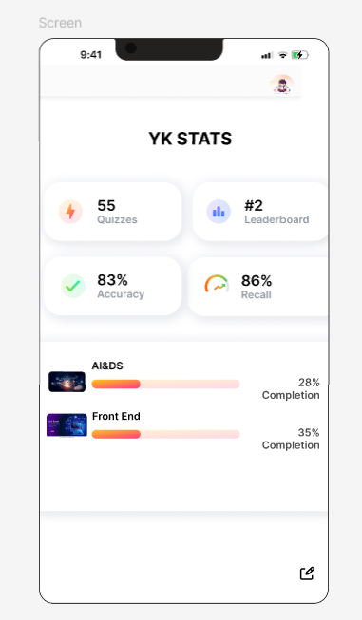
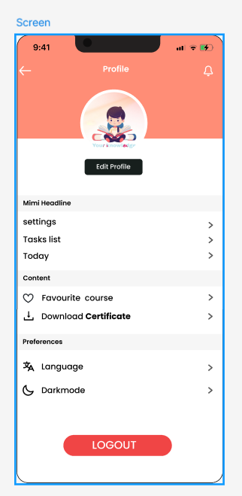
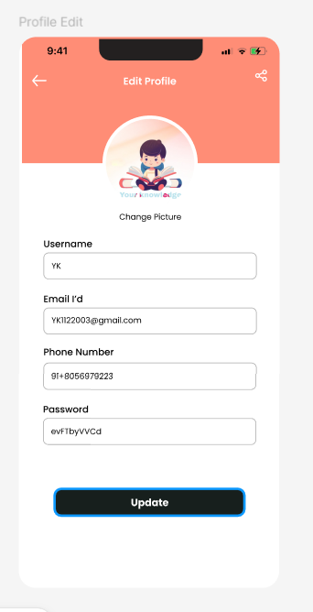

Slide 22
Thank You

